Slide 1

Internship Opportunities Forecasting
*
Peng Jiang

Slide 2
Project Description
Goal: Based on historical, dynamic companies data and current period of student data, predict and match the companies demand in the future accordingly. (Extend here, plus motivation) what who why

Slide 3
Project Breakdown
Phase 1 | Phase 2 | Phase 3 | Phase 4 | Phase 5
Requirement clarification | Research, data collection and evaluation | Design | Prototype delivery | Implementation

Slide 4

Project Lifecycle
The project operation methodology is inspired by Cross-industry standard process for data mining, CRISP-DM (Shearer, 2000):
Business Understanding
Data Understanding
Data Preparation
Modeling
Evaluation
Deployment

Slide 5

Phase 1: Requirement Clarification
Build relationship
Communicate effectively
Understand the project
Specify the input and outcome of the project
“What’s going on and what need to be done by operating the project?”

Slide 6
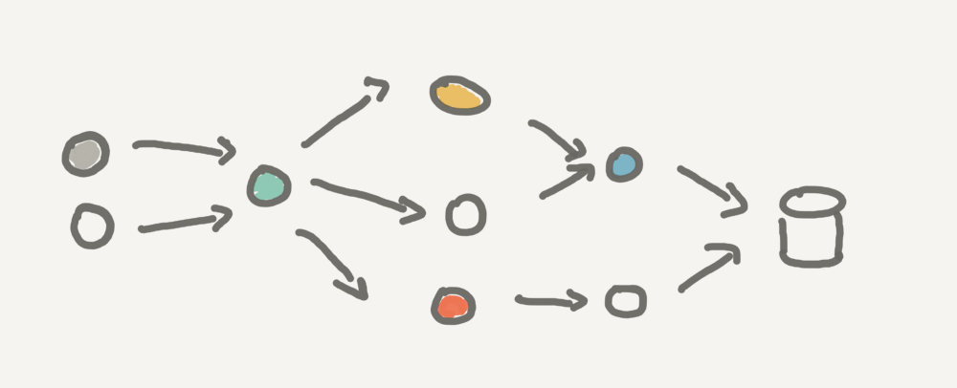
Phase 2: Preparation – Data
Raw data collection:
Companies and contactors
Contact information from Trello board
Students Internship placement in each period
“What’s the relation among different data sets?”

Slide 7








Phase 2: Research on Tech
Technical Limitations:
License cost
Complexity
Multi-platform
Extensibility
Maintainability
“What to use to build the application?”

Slide 8
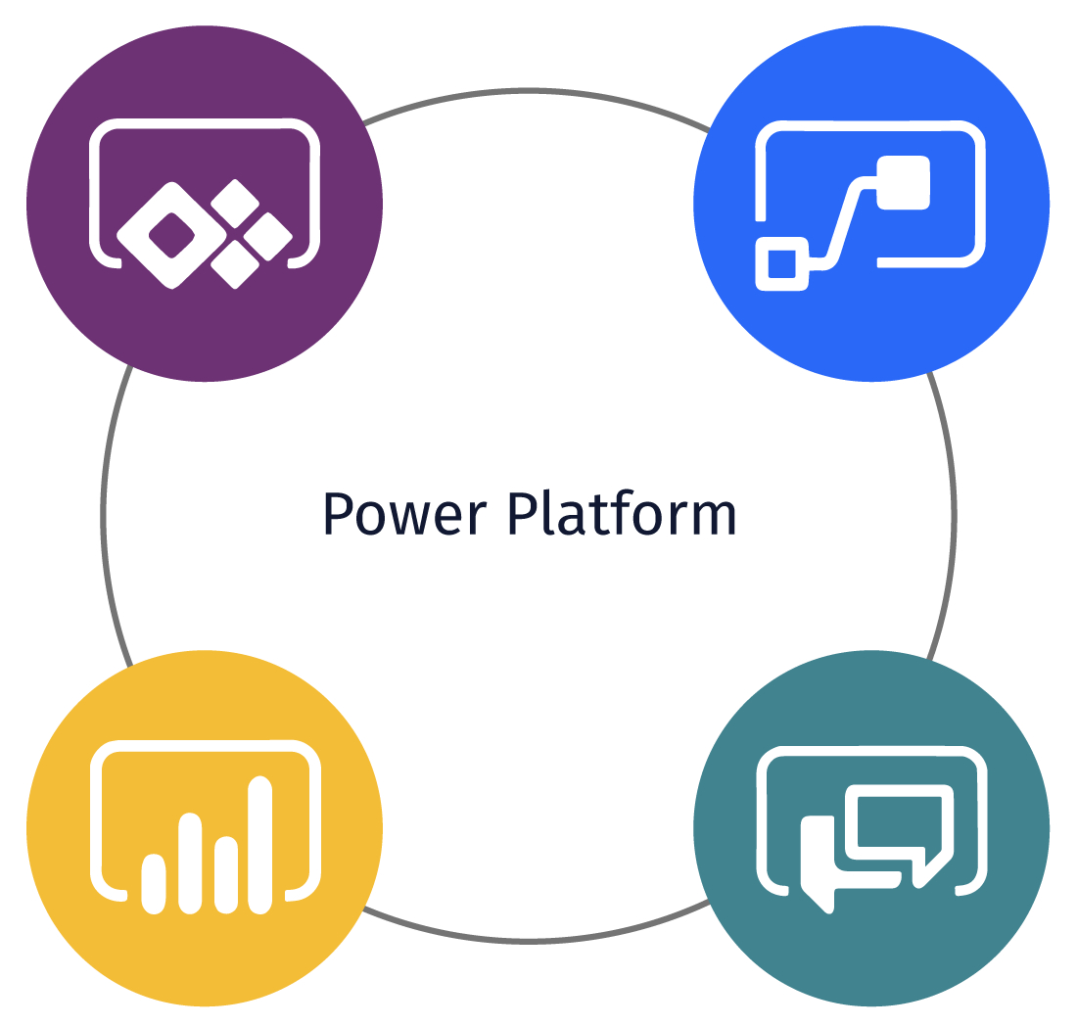

To power or not to power
Pros:
Strong functionality
Flexible to access / embed
Develop friendly
Cons:
Costly in business use
Not suitable for small group

Slide 9
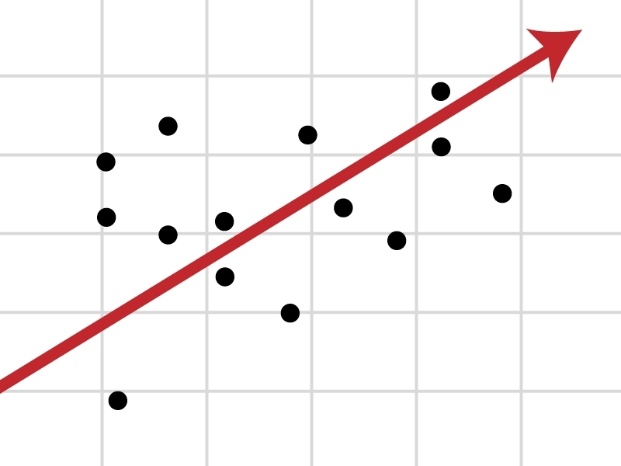
Phase 2: Research on Model
Instead of time series forecasting, it’s more accurate to conduct regression when the outcomes are closely related to independent variables (Nikolopoulos et al., 2007).
Set prediction model simple and abstract proper factors and weight from real world (Green, 2015).
Wang et al. (2012) provided examples of building multi-regression model from higher level observation.
Tencaliec et al. (2015) build “intuitive” model at the first place, then improve it literally.

Slide 10
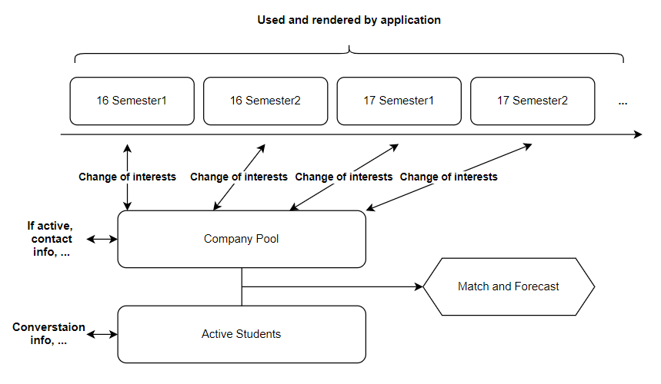
Phase 3: Design - Database

Slide 11

Phase 4: Design - UI
Dashboard & Tables:
Data can be summarized properly
Free to extend
Present data in clear manner

Slide 12
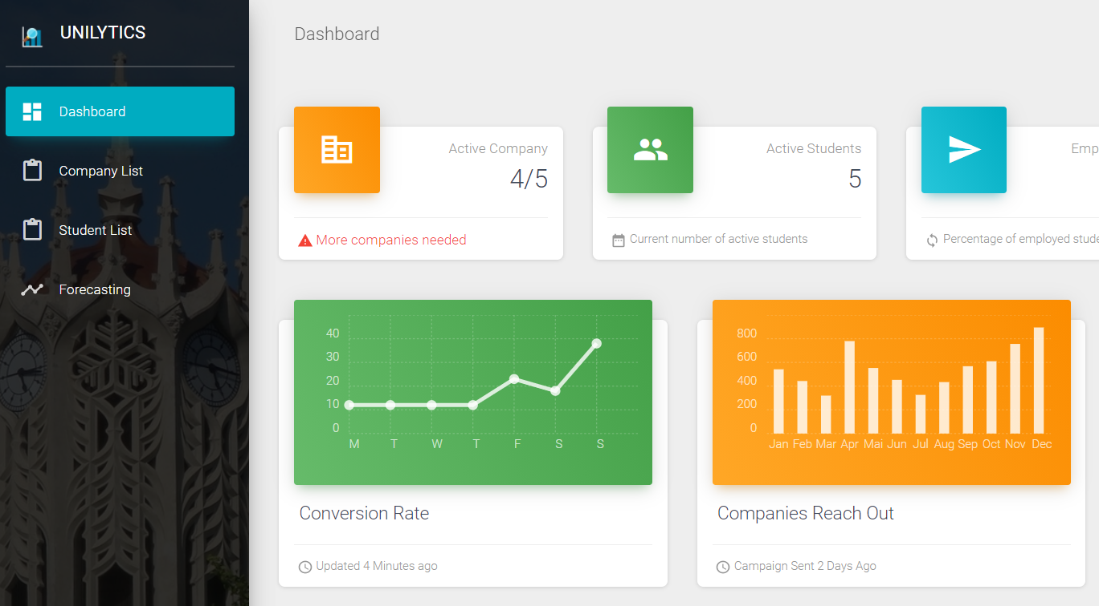
Phase 5: Prototype Delivery

Slide 13
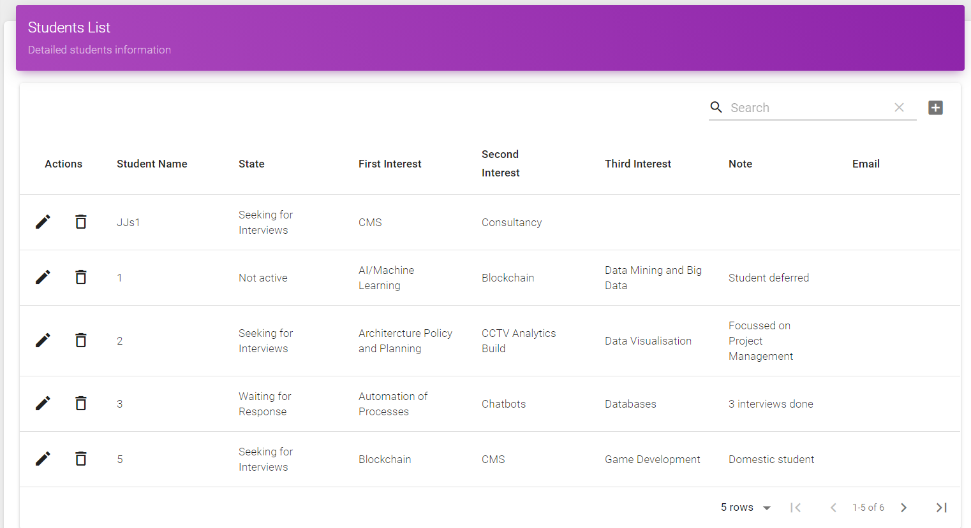
Phase 5: Prototype Delivery

Slide 14
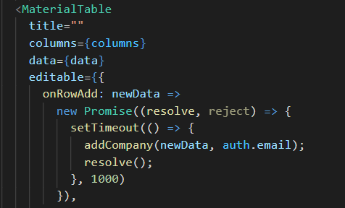
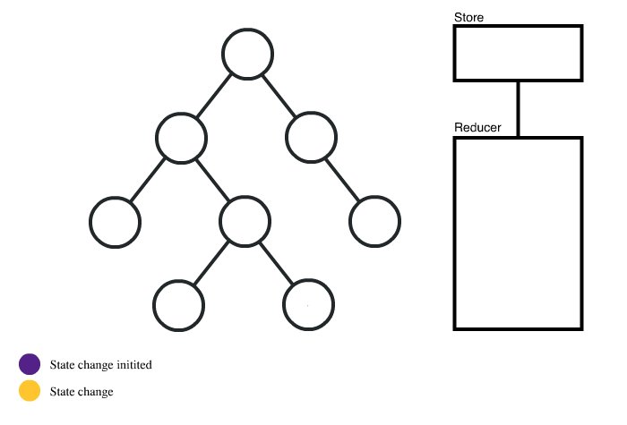
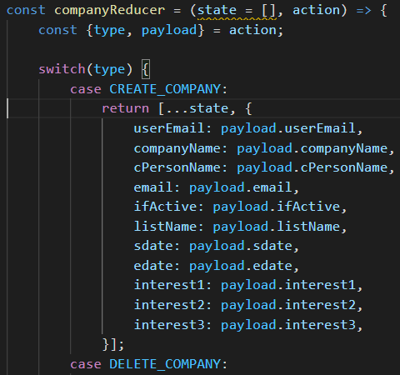
Phase 6: Implementation
Component:
Reducer:

Slide 15
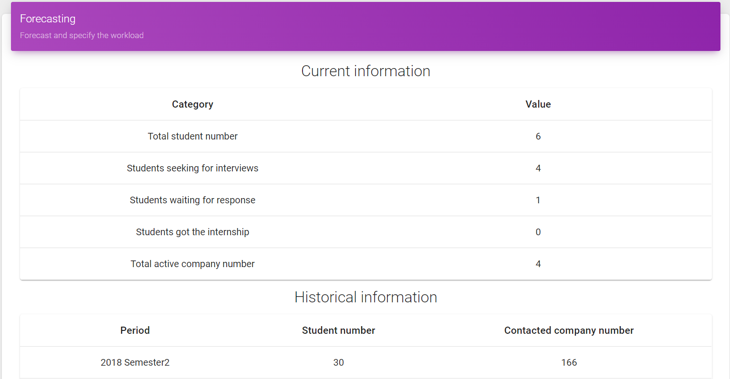
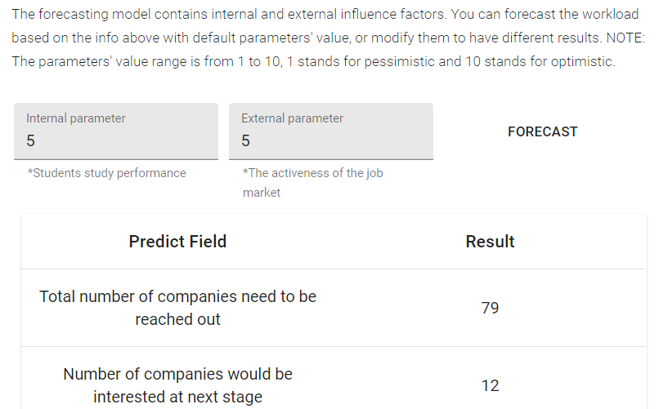
Phase 6: Implementation

Slide 16
Interpersonal Skills
Communication: Understand the tasks, gain expectations and specify clients’ needs.
Negotiation: Balance resources: time, technique complexity, functionality, cost …
Collaboration: Effective teamwork
Risk Management: Have multiple plan in each phase
Creative and Flexible Thinking: Optimize solutions

Slide 17
Application of Knowledge
Technical:
COMPSCI 718: Programming for Industry
COMPSCI 719: Programming with Web Technologies
COMPSCI 732: Software Tools and Techniques
COMPSCI 753: Algorithms for Massive Data
Complementary:
INFOSYS 722: Data Mining and Big Data
OPSMGT 757: Project Management
Workshops:
Workshop 4: Information search, evaluation and tips on report writing
Workshop 5: Innovation and creative thinking
Workshop 7: Professional networking | Dos and Don'ts at work

Slide 18
Reference
Green, K. C., & Armstrong, J. S. (2015). Simple versus complex forecasting: The evidence. Journal of Business Research, 68(8), 1678-1685.
Shearer, C. (2000). The CRISP-DM model: the new blueprint for data mining. Journal of data warehousing, 5(4), 13-22.
Tencaliec, P., Favre, A. C., Prieur, C., & Mathevet, T. (2015). Reconstruction of missing daily streamflow data using dynamic regression models. Water Resources Research, 51(12), 9447-9463.
Nikolopoulos, K., Goodwin, P., Patelis, A., & Assimakopoulos, V. (2007). Forecasting with cue information: A comparison of multiple regression with alternative forecasting approaches. European Journal of Operational Research, 180(1), 354-368.
Wang, X., Chen, Z., & Yang, S. (2012). Forecasting modeling and simulation analysis of a power system in China, based on a class of semi-parametric regression approach. South African Journal of Industrial Engineering, 23(3), 154-168.

Slide 19
Thanks!
Feb, 2021

